Slide 1
Propulsion Systems for e-VTOL Aircraft
Jordan Eriksen
Supervised by Dr Sam Grimshaw

Slide 2
Quadcopter market to treble in next 5 years
Most practical solution to personal air transportation
Ducted-fans more efficient as a stand-alone propulsor
Notes:
Background
Research conducted at the beginning of the year shows that the Global Quadcopter Market will reach a value of $43 billion by 2024.
Practical in terms of:
no requirement for take-off/landing infrastructure;
Electrically powered therefore potential for a greener solution as not fossil fuels;
Reduced transportation times.
As a stand-alone propulsor, ducted fans are more efficient than an open rotor as shown by the figure of merit.

Slide 3
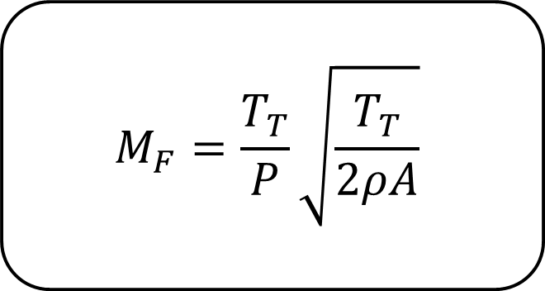
Figure of Merit
$$M_{F}=\frac{T_{T}}{P}\sqrt{\frac{T_{T}}{2ρA}}$$
Other Benefits
Casing reduces noise
Blades shielded – SAFER
Notes:
In order to determine whether or not a propulsor is more efficient, the non-dimensional ‘Figure of Merit is used.
Figure of Merit
Defined as above, with;
T_T = Total thrust
P = Power (shaft or electrical provided consistency is retained)
A = flow area
This allows a propulsor design to be compared to existing designs by evaluating a non-dimensional measure of propulsor effectiveness
“INCREASE IN THRUST FOR A GIVEN POWER INCREASE M_F”
Ducted fans also have other benefits
The duct around the fan provides acoustic damping thus reducing the sound emitted by the propulsor
The duct also acts as a shield from the blades themselves, reducing the chance of any users being injured by blades, crucial if these are to be used as personal transportation in cities.

Slide 4
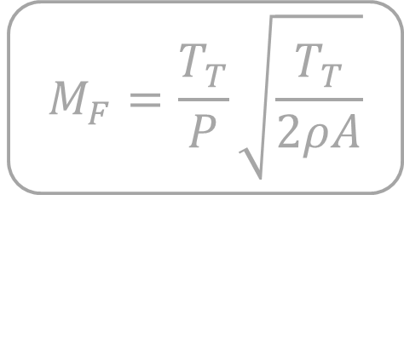
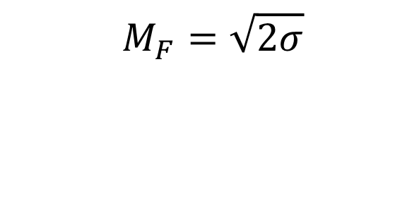

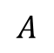
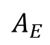
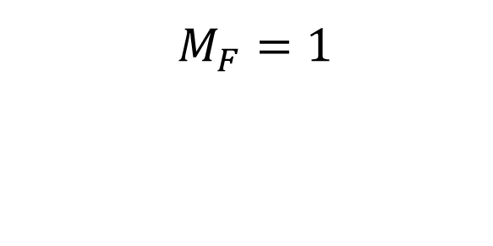
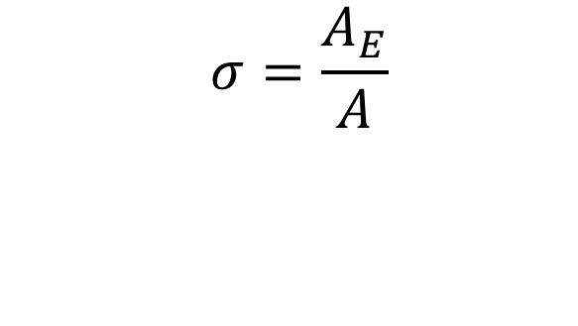
$$M_{F}=\frac{T_{T}}{P}\sqrt{\frac{T_{T}}{2ρA}}$$
$$A$$
$$A_{E}$$
$$M_{F}=1$$
$$M_{F}=\sqrt{2σ}$$
$$σ=\frac{A_{E}}{A}$$
$$A$$
Notes:
A simple analysis of an open rotor, modelled as an velocity actuator disk with exit flow area A and exit pressure = ambient, gives an ideal M_f = 1
The same analysis with a ducted fan, considered as a pressure actuator disk with flow area A, exit area A_e and exit pressure = ambient, gives an ideal M_f = sqrt(2* \sigma)
Sigma is the diffusion factor or area ratio of the duct. Hence even without diffusion M_f is increased by over 40%.

Slide 5
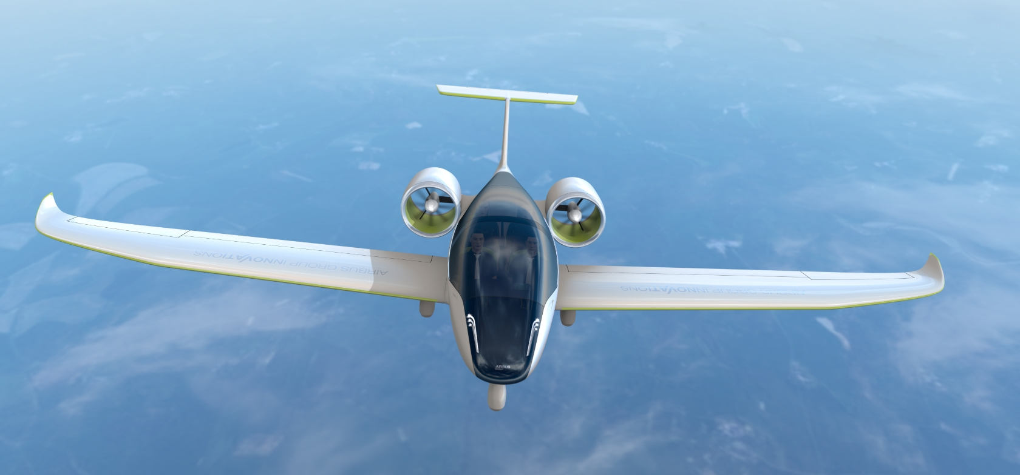
Current Trends
Notes:
Airbus E-FanX fixed wing with electric ducted fan propulsion
Completing flight tests

Slide 6
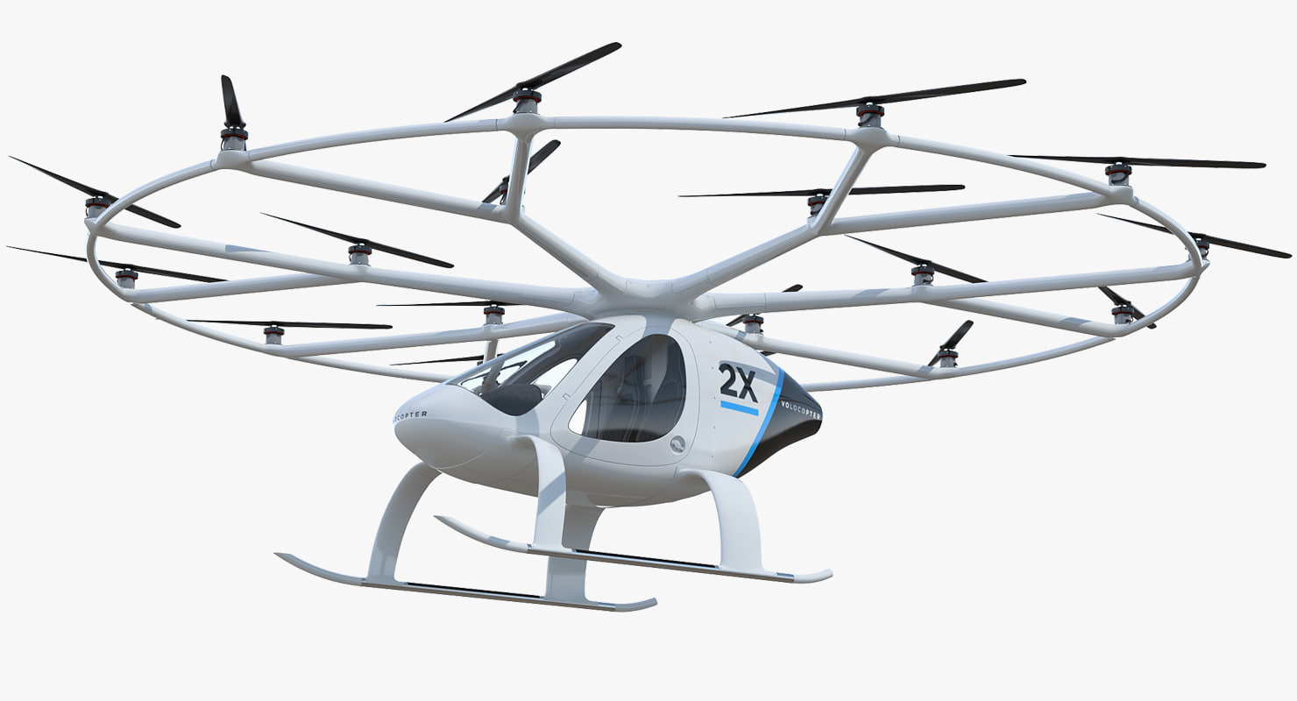
Current Trends
Notes:
Volocopter multirotor open rotor e-VTOL
Completing flight tests for personal transportation in UAE

Slide 7
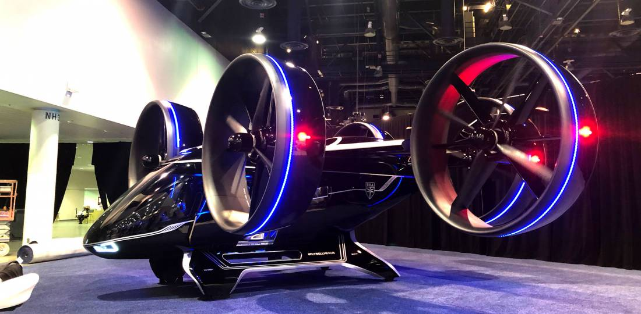
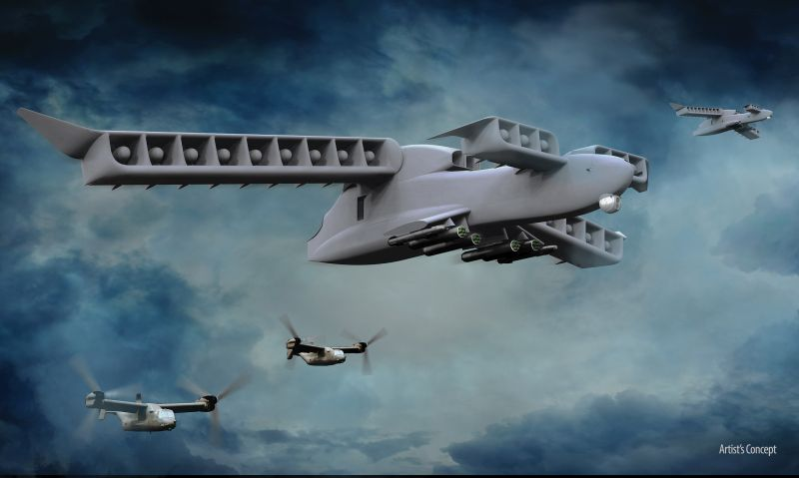
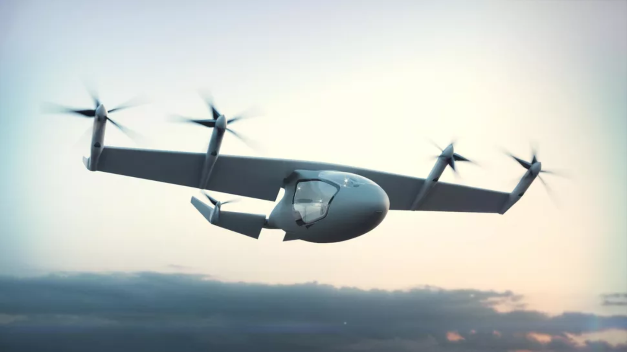
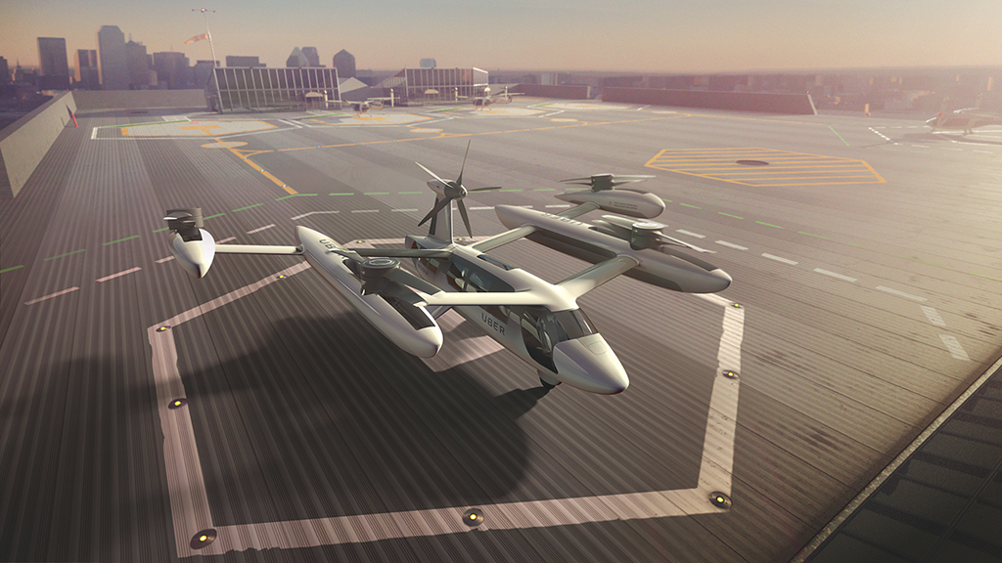
Notes:
FUTURE TRENDS
- Bell Nexus (hexacopter, tilt-rotor, short hops no need for fixed wing efficiency) (NW)
Roll Royce e-VTOL (tilt-rotor, folding rotor to transition to fixed wing flight) (SW)
UBER backed concept (quad contra-rotating with fixed wing forward propulsor) (SE)
Artist concept of ducted tilt wing design (NE)

Slide 8
Themes …
EFFICIENCY at the cost of VERSATILITY
VERSATILITY at the cost of COMPLEXITY
Notes:
EFFICIENCY AT THE COST OF VERSATILITY
Ducted fans used in E-FanX design but as a pure fixed wing requires TO/Landing infrastrure. Maximises efficiency. Low versatility.
Designs attempting to maximise versatility (Rolls/Uber) pay cost of efficiency (by not using ducted fans) AND complexity (either with tilt-wing design transitioning between vertical and horizontal flight modes or UBER design with two separate systems, one for TO/Landing one for free flight).

Slide 9
How can we simplify efficiency?
Is a well designed ducted fan a feasible solution?
Notes:
The current and future trends show efficiency isn’t always the top priority
Can ducted fans be utilised in a way that allows them to efficiently drive a vehicle in any mode of operation? (VERITCAL/TRANSITIONAL)
BIG PICTURE QUESTIONS FROM WHICH TO DISTILL PROJECT AIMS

Slide 10
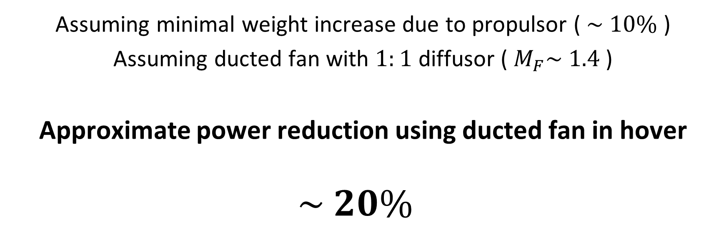
Assuming minimal weight increase due to propulsor ( $\sim 10\%$ )
Assuming ducted fan with $1:1$ diffusor ( $M_{F}\sim 1.4$ )
Approximate power reduction using ducted fan in hover
$$\sim 20\%$$
Notes:
From previous slide, is a ducted fan a potential solution?
Why are ducted fans a potential solution? What does figure of merit actually show?
…
Hence, there are real potential gains to be made in the efficiency of an e-VTOL system by incorporating ducted fans into the design.
IF NEED TO EXPLAIN
This is calculated from M_F = T/P * sqrt(T/(2rhoA)) from slide 3+4.
Set T = 1.1T and M_f = 1.4
Therefore P = 0.8P
Minimal weight assumption needs to be verified…leading to the next slide

Slide 11
Are ducted fans a more efficient SYSTEM for e-VTOL vehicles?
STATIC analysis of performance
Does added efficiency outweigh weight penalty for a simple light-weight design?
Notes:
Leads onto the aims of this project (1)
It can be shown that a ducted fan is more efficient in a work-top environment, but how does it weigh up when utilised in an application driven scenario that accounts for the whole system (extra weight and operational complexity (such as working line hysteresis))?
Is a ducted fan propulsor a more efficient SYSTEM than a standard open-rotor for personal e-VTOL vehicles?

Slide 12
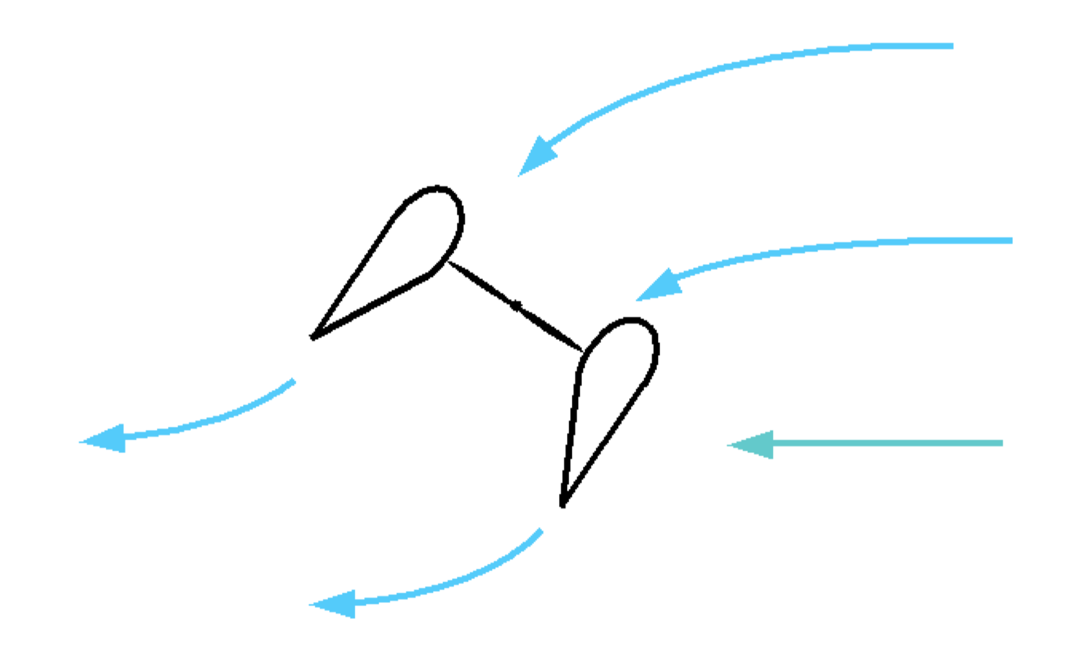
Are ducted fans FEASIBLE in an e-VTOL application?
DYNAMIC analysis of performance
Does separation occur on the inlet during simple manoeuvres?
How will the control system cope with the propulsor response?
CROSSWIND
Notes:
Leads onto the aims of this project (2)
The operation of the system in a dynamic environment must also be considered. For example, will crosswinds on the duct intake affect propulsor performance when undertaking simple manoeuvres? How can weight be minimised whilst ensuring flow separation is avoided? (This is explored in detail by Megan and so isn’t discussed in detail here. However, future work will incorporate the testing of her ducted fan developments on the equipment used in this project).
Are ducted fans FEASIBLE in an e-VTOL application?

Slide 13
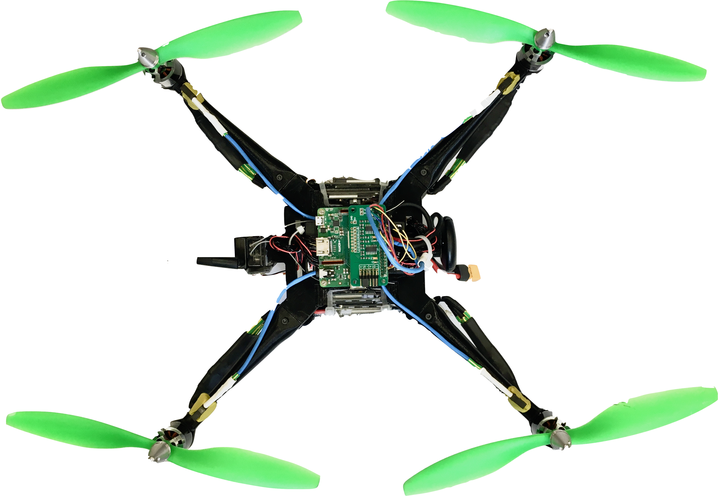
The Drone
Wireless Telemetry
Pixhawk4 Flight Controller
Light-weight 3D printed parts (PLA)
Modular
Pixhawk4 control system
Bespoke chassis
RPi based on-board, real-time sensor hub
RPi3 A+ Sensor Management
(with ADC breakout)
Electronic Speed Controller (ESC)
External GPS
RPM Sensor
Detachable Propulsor Assembly
(allow for ducted fan)
Notes:
The above questions show that an independent SYSTEM incorporating real world factors such as electrical and control system performance, as well as aerodynamic performance, is required to prove efficiency of the ducted fan.
How do real constraints such as minimising mass effect the performance of the vehicle
Can an off the shelf, SIMPLE control system be used in tandem with a ducted fan and be resilient to variation in fan performance with environmental factors (such as crosswind)?
Further, testing of dynamic behaviour (unsteady behaviour at that, transition from hover to horizontal motion for example) is required to prove the fan is feasible as well as more efficient.
Ducted fans have been proven to be more efficient, the next step is feasibility in an application driven context.
THE DRONE
Designed to be versatile, modular and light-weight to allow for quick replacement of 3D printed parts that can be designed and made in house at the Whittle Lab. This allows rapid prototyping of new designs and replacement parts.

Slide 14
Sensors and Control
Laptop
Pixhawk4 Flight Controller
Data handling, flight control and sensor management
Control Sys
Power Module (PM07)
RPi3 A+ Sensor Management
Motors, speed controllers and power distribution systems
Power Sys
ONBOARD
ESC
ADC Breakout
Aero, power and speed sensors
RPM Sensors
Ultrasound Proximity Sensors
Sensors
Pressure Transducers
Motor Assembly
Notes:
SENSORS AND CONTROL
This slide outlines the systems used to control the drone. They are divide into 3 main blocks:
Control Systems
Out the box flight control hardware Pixhawk4 (including power module to manage battery power and distribute power accordingly) and associated PX4 software.
WiFi enabled Raspberry Pi to manage on-board sensors and allow data relay in real time back to ground station. Has functionality to manage on-board ultrasound sensors to control the drone position and prevent collision.
Power Systems
Power module to manage motor currents and battery. Battery used is a 4-cell LiPo with 5000mAh capacity and maximum discharge of 125 – 165 Amps.
50A ESC (Electronic Speed Controllers) to convert throttle signal to 3 phase motor input.
Motor assembly
BLDCM NTM Prop Drive Series 2826 1000kv. MAX I = 15 A. MAX P = 235W.
Standard 10in diameter props.
OR 10in, 3.7in pitch APC prop
Sensors
RPM Sensors, mounted on arms holding motor assembly. Count revolution time and average over 10 readings to determine RPM.
ADC breakout
Additional board connected to the RPi enabling ADC at 12, 14, 16 or 18 bits of resolution over 8 channels.
Pressure Transducers. Enable pressure readings using simple pressure transducers and ADC breakout. Provides facility for measuring intake and exit profile during manoeuvres.
Ultrasound proximity sensors allow the exact position of the drone within it’s test environment to be determined and allows automation of drone positioning within the environment.
3 Axis sensors (forward, right and down)

Slide 15
Ducted Fan Design
Aim
Minimise power required for hover-flight
Constraints
Thrust = Vehicle weight
Notes:
Ducted fan has a broad design space and so this must be reduced in order to obtain a design that is fit for purpose, as well as having some optimisation included with the aim of reducing the power to weight ratio.
A simple mass model is used to determine the variation in weight of a specific design point. This allows the performance of various designs to be compared using a range of metrics such as power required, total thrust (set equal to vehicle weight) and figure of merit.

Slide 16
Ducted Fan Design
Process
Determine which variables are fixed and which are floating
Determine relationship between these variables
See how variation of design point effects operating point performance
Notes:
Ducted fan has a broad design space and so this must be reduced in order to obtain a design that is fit for purpose, as well as having some optimisation included with the aim of reducing the power to weight ratio.
A simple mass model is used to determine the variation in weight of a specific design point. This allows the performance of various designs to be compared using a range of metrics such as power required, total thrust (set equal to vehicle weight) and figure of merit.

Slide 17




Operating Point Variables
$$Φ, ψ, Ω$$
Assemble Variables
Geometric Variables
$$r_{c}, r_{h}, σ$$
Floating Variables
$$Φ, ψ, r_{c}, σ$$
Fix Variables
Fixed Variables
$$r_{h}$$
Notes:
Considering all the variables, they can be subcategorised into Operating point variables (those which determine how the propulsors perform but can be varied once it is built) and the geometric variables (those that are fixed from the point of construction):
OP variables
PHI Flow coefficient
PSI Stage loading
OMEGA Fan Speed
Geometric variables
r_c Casing radius
r_h Hub radius
SIGMA diffusion factor
Initially the only variable that can be fixed is the hub radius, determined by the outer radius of the electric motor used to drive the rotor.

Slide 18
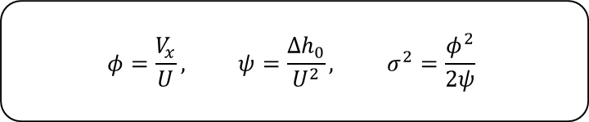
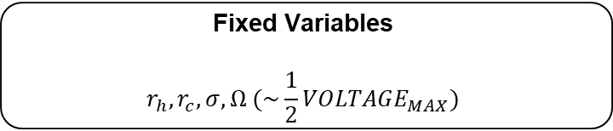


$$φ=\frac{V_{x}}{U}, ψ=\frac{Δh_{0}}{U^{2}}, σ^{2}=\frac{φ^{2}}{2ψ}$$
Variable relationships
$$If T_{T}=W_{T} ∴r_{c}={\left(r_{c}\right)}_{CRITICAL}$$
Floating Variables
$$Φ, ψ$$
NEW Fixed Variables
Fixed Variables
$$r_{h}, r_{c}, σ, Ω (\sim \frac{1}{2}{VOLTAGE}_{MAX})$$
Notes:
This can be vastly simplified by considering the relationship obtained between the OP variables PHI and PSI and SIGMA. This arises from two assumptions
that the exit static pressure is atmospheric.
That the rotor stagnation pressure rise is almost isentropic hence PSI = delta P_0 / rho U^2
The constraint that the total thrust must be equal to the weight results in a critical condition on the casing radius. The thrust output will become greater than the weight of the drone at a specific critical casing radius r_c_crit
This is explained further in subsequent slides about the mass model
OMEGA is also chosen to be fixed, set by both the battery voltage and the kV of the motors used. OMEGA is chosen to be at approximately half of the maximum voltage, giving OMEGA = ½ * (15V) * 1000 = 7500 RPM

Slide 19
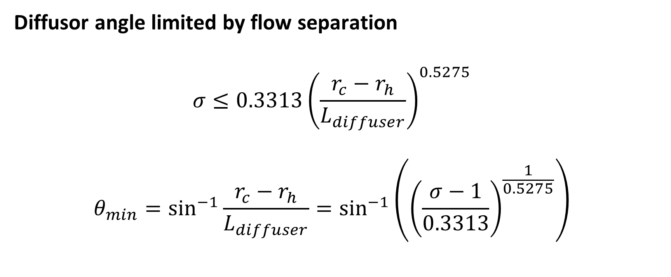
Mass Model
Diffusor angle limited by flow separation
$$σ≤0.3313{\left(\frac{r_{c}−r_{h}}{L_{diffuser}}\right)}^{0.5275}$$
$$θ_{min}=\sin^{−1}{\frac{r_{c}−r_{h}}{L_{diffuser}}}=\sin^{−1}\left({\left(\frac{σ−1}{0.3313}\right)}^{\frac{1}{0.5275}}\right)$$
Notes:
When considering the mass model, a hidden fixed geometric variable, diffuser length, is set by the maximum angle of the diffuser from the axial flow direction.
The constants shown here are obtain from empirically obtained data in ESDU 75026 and represent a conservative limit on diffuser separation.
The equation shows that this limit can be expressed solely in terms of SIGMA (diffusion ratio) and hence the operating point variables PHI and PSI.

Slide 20
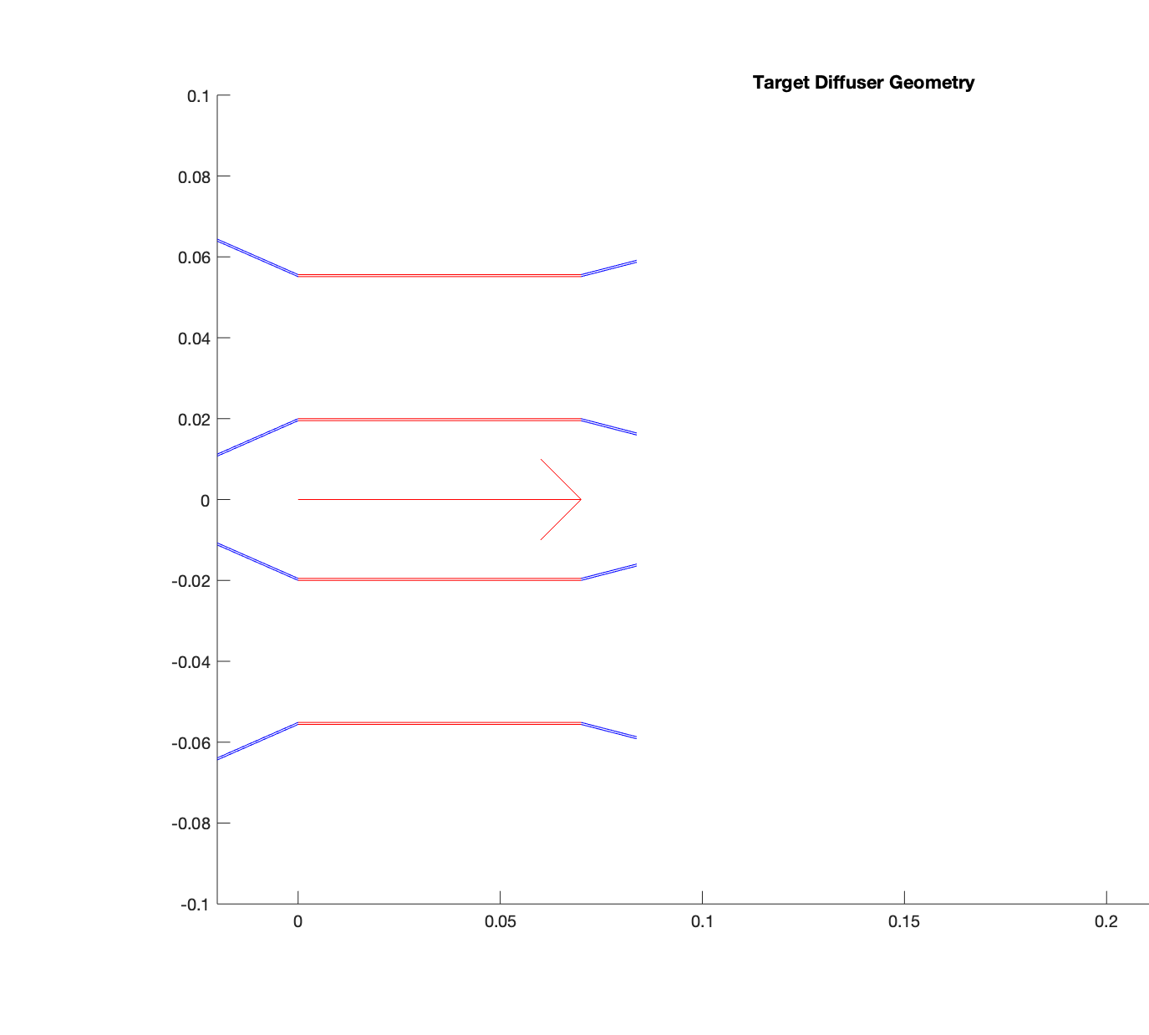
Mass Model
Example geometry section with direction of flow indicated and inlet and diffuser shown in blue.
Inlet geometry constant, diffuser geometry changes with operating point.
Notes:
Using the previous limit on diffusor angle, the length can be minimised by designing the diffuser to be annular with the same flow angle at the hub as at the casing resulting in the above geometry.
Both the diffusor and inlet are modelled as hollow truncated cones with skin thickness given by t, here t approximately 2mm.
Red turbomachinery section modelled as two tubes. Outer tube has thickness t at a radius of r_c and inner tune has a thickness of 5mm (for structural purposes) and radius of r_h.

Slide 21
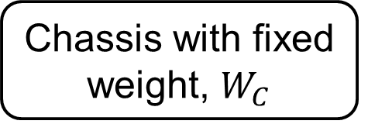
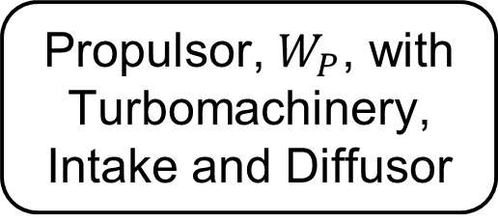

Mass Model
Propulsor, $W_{P}$, with Turbomachinery, Intake and Diffusor
x4
Chassis with fixed weight, $W_{C}$
$$W_{T}=W_{C}+4W_{P}$$

Slide 22
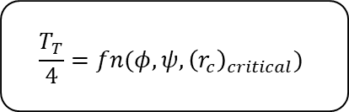
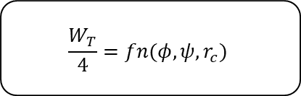
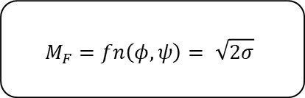
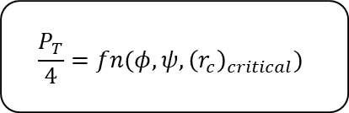
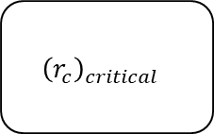
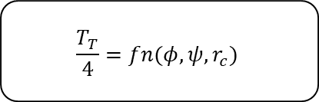
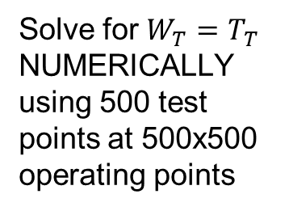
Visualising Propulsor Performance
$$\frac{P_{T}}{4}=fn(φ, ψ,{\left(r_{c}\right)}_{critical})$$
$$\frac{W_{T}}{4}=fn(φ, ψ,r_{c})$$
Solve for $W_{T}=T_{T}$ NUMERICALLY using 500 test points at 500x500 operating points
$${\left(r_{c}\right)}_{critical}$$
$$M_{F}=fn\left(φ, ψ\right)= \sqrt{2σ}$$
$$\frac{T_{T}}{4}=fn(φ, ψ, r_{c})$$
$$\frac{T_{T}}{4}=fn(φ, ψ,{\left(r_{c}\right)}_{critical})$$
Notes:
How the output propulsor performance varies as a function of PHI and PSI can be visualised by evaluating each performance metric at every design point. The value of r_c was set individually at each design point for the case where TOTAL WEIGHT = TOTAL THRUST. This must take into account the mass of the chassis and so is a function of how lightweight the rest of the drone can be made.

Slide 23
Visualising Performance - POWER
SHOW PLOT OF POWER HERE
EXPLAIN LIMITS
T = W limits
Diffuser = 1
Diffuser max length
TREND FOR r_c TO BE MAXIMISED FOR A GIVEN M_F TO REDUCE POWER
CONSIDER SMITH CHART OVERLAY – EFFICIENCY LOSES IN BOTTOM RHS OF PLOT
BOTTOM LHS, POWER GAINS SMALL FOR LARGE INCREASE IN r_c therefore NOT TOO BIG
Notes:
As the primary objective now is to minimise the power draw, as by definition every design point above has been chosen with T = W, this suggests operating in the bottom RHS of the plot with high values of flow coefficient and low stage loading.
However, some limits also apply:
Firstly (and least significantly) is the diffusion SIGMA = 1 limit at which the diffusor no longer diffuses and the fan has an exit Area = flow area.
Secondly, the curve cutting off the bottom left corner of the plot represents the region of the plot at which the required casing radius for T = W is larger than the limit set (r_c < 100mm).
Finally, the curve bottom right represents the limit at which the diffusor is no longer symmetric. At this point the hub of the diffusor is a full cone and so any increase in exit area can only be achieved by increasing the diffusor casing.
SHOW THE M_F CURVE AND A DIFFUSER GEOMETRY WITH A DIFFUSER HUB CONE TO EXPLAIN THIS

Slide 24

Chosen Design
Variable | Value
Flow coefficient, $φ$ | 0.85
Stage loading,$ψ$ | 0.25
Casing radius, $r_{c}$ | TO BE CONFIRMED
Fan speed, $Ω$ | 7500 RPM
Diffusion factor, $σ$ | TO BE CONFIRMED

Slide 25
Results (so far)

Slide 26
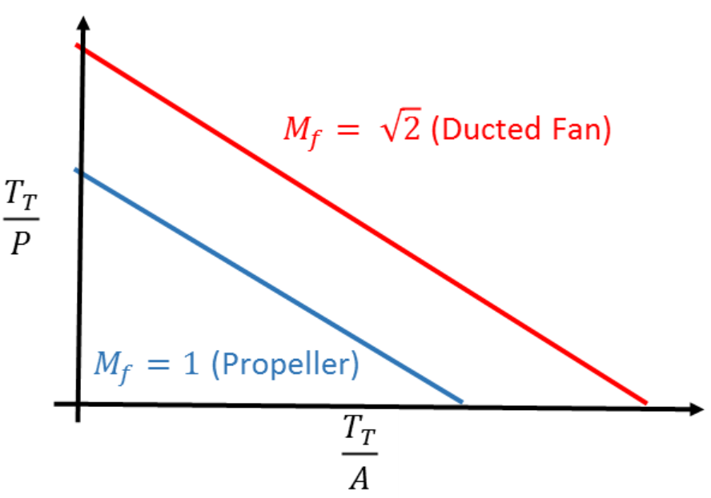
Ideal Case
Notes:
The ideal propulsors discussed earlier can be plotted to show the difference in performance between open-rotors and ducted fans.

